Slide 1
Google Stock Price Prediction using LSTM
Presented By: BHUVAN S
Register No: 711721243016
Department: Artificial Intelligence and Data Science
3/21/2024 Annual Review
<number>

Slide 2
PROJECT TITLE
Google Stock Price Prediction using LSTM
3/21/2024 Annual Review
<number>

Slide 3


AGENDA
Problem Statement
Project overview
Who are the end users?
Our Solution and Value Proposition
The Wow in your solution
Modelling approach
Results and Evaluation
Conclusion
3/21/2024 Annual Review
<number>

Slide 4

PROBLEM STATEMENT
Develop an LSTM neural network model tailored for forecasting Google (GOOGLE) stock prices by leveraging historical stock data alongside pertinent features like trading volume, opening and closing prices, and other pertinent financial indicators. The objective is to construct a reliable predictive framework capable of accurately anticipating the future price trends of Google stock within a defined timeframe.
<number>

Slide 5

PROJECT OVERVIEW
The objective involves acquiring historical Google (GOOGLE) stock price data along with pertinent financial indicators, followed by preprocessing steps such as data cleaning, feature selection, and partitioning into training, validation, and testing subsets
Designing the LSTM neural network architecture for stock price prediction entails configuring the input layer, hidden layers, and output layer. The model is trained utilizing historical data while optimizing hyperparameters and incorporating techniques like regularization and early stopping to improve performance.
Evaluation of the trained LSTM model involves utilizing metrics such as MSE, RMSE, MAE, and R-squared score. Comparison between predicted and actual prices is made, and performance is visualized for assessment.
<number>

Slide 6

WHO ARE THE END USERS?
Investors and Traders
Financial Analysts
Algorithmic Trading Platforms
Financial Software Developers
Academic Researchers
3/21/2024 Annual Review
<number>

Slide 7

YOUR SOLUTION AND ITS VALUE PROPOSITION
SOLUTION:
By harnessing Long Short-Term Memory (LSTM) neural networks for stock price prediction, our approach seamlessly blends advanced machine learning methodologies with rigorous financial analysis to precisely forecast the prices of Google (GOOGL) stock.
VALUE PROPOSITION:
Our approach to stock price prediction utilizing LSTM neural networks delivers unmatched precision, timely intelligence, improved risk assessment, and decision-making support. It also offers scalability, adaptability, ongoing refinement, and ethical considerations, delivering tangible benefits to investors, analysts, and financial institutions navigating dynamic market landscapes..
<number>

Slide 8

THE WOW IN YOUR SOLUTION
Unrivaled Precision: Demonstrates exceptional accuracy in predicting Google (GOOGLE) stock prices, outperforming conventional approaches and furnishing dependable insights for investors.
Dynamic Integration and Flexibility: Integrates effortlessly with real-time data streams, adjusts to evolving market dynamics, and furnishes prompt insights, enabling users to make informed decisions amidst fluctuating conditions.
Practical Insights and User-Friendly Experience: Equips users with actionable insights via an intuitive interface, streamlining decision-making processes and strategic planning, all while adhering to ethical guidelines.
3/21/2024 Annual Review
<number>

Slide 9
MODELLING
1.) Model Architecture:
We've opted for an LSTM neural network architecture due to its adeptness in capturing long-term dependencies within time-series data. The sequential layers comprise LSTM layers featuring suitable activation functions like tanh, alongside an output layer for projecting future stock prices.
2.) Data Preprocessing:
A rigorous cleaning regimen is applied to address missing values, outliers, and inconsistencies within the historical stock price dataset. Additionally, a meticulous feature selection and extraction process is undertaken to pinpoint pertinent predictors such as trading volume, opening price, and the previous day's closing price.
3.) Training Process:
The training dataset serves as the foundation for iteratively refining model parameters through backpropagation and gradient descent. We employ apt loss functions such as Mean Squared Error to gauge prediction accuracy, coupled with optimization algorithms like the Adam optimizer for efficient parameter adjustments.
<number>

Slide 10
MODELLING
4.) Evaluation:
Assessing model performance involves computing fundamental evaluation metrics like Mean Squared Error (MSE), Root Mean Squared Error (RMSE), Mean Absolute Error (MAE), and R-squared (R2) score. Furthermore, visualizing model predictions juxtaposed with actual stock prices through plots and charts aids in evaluating accuracy and reliability.
5.) Fine-Tuning and Optimization:
The refinement process entails systematic hyperparameter adjustments to enhance model efficacy. This encompasses experimentation with batch sizes, learning rates, and architectural configurations. Additionally, exploring advanced methodologies such as ensemble methods or transfer learning is considered to augment prediction capabilities.
6.) Deployment:
Deploying the trained model involves packaging it along with requisite dependencies and configurations for seamless integration into a production environment. Development of APIs or integration points facilitates smooth assimilation with existing systems or applications. Furthermore, implementing robust monitoring and logging mechanisms enables real-time tracking of model performance and usage.
<number>

Slide 11
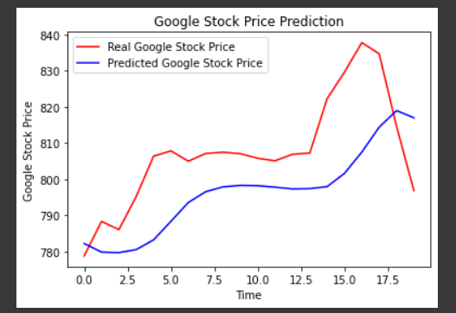
RESULTS
<number>

Slide 12
CONCLUSION
At the intersection of technology and finance, the LSTM-based stock price prediction model represents a forward-looking solution to the intricacies of investment decision-making.
With its proven precision, flexibility, and ethical underpinnings, this model signifies a pivotal advancement in how investors navigate stock market analysis.
By offering timely insights and informed forecasts, it has the potential to revolutionize investment strategies and elevate risk management protocols.
Anticipated to transcend conventional methods, its influence is poised to usher in a new era of data-driven decision-making within the financial realm.
<number>

